Slide 1
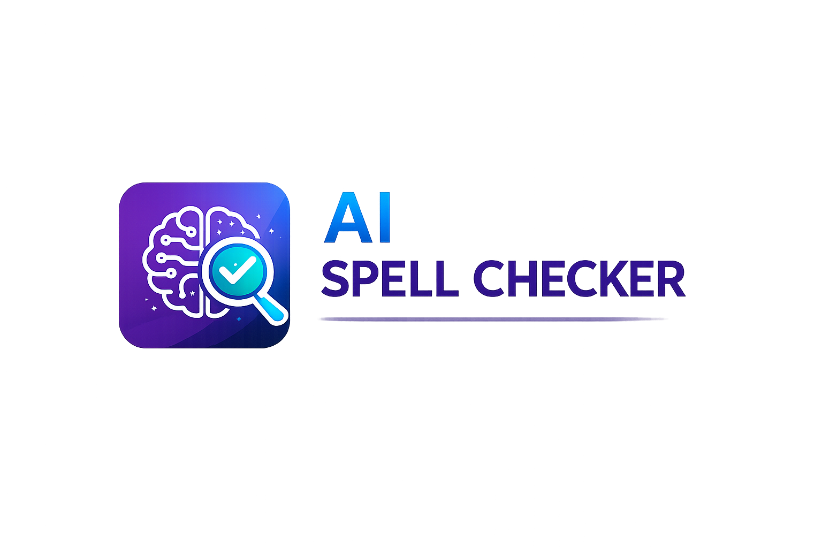
AI SPELL CHECKER APP
Natural Language Processing Project
Presented By:
Qurat ul Ain
Ikram Javed
Sania Mariyam
AI Spell Checker App | NLP Project

Slide 2
Project Overview
An AI-powered mobile application for spell and grammar correction.
Built using Flutter and Natural Language Processing.
Provides intelligent suggestions instantly.
Helps improve communication and writing quality.
AI Spell Checker App | NLP Project

Slide 3
Introduction & Problem Statement
.
People make spelling and grammar mistakes daily Manual proofreading takes time and effort.
Poor writing affects professionalism and communication.
Our app solves this problem using AI and NLP.
AI Spell Checker App | NLP Project

Slide 4
How the System Works
1. User enters or pastes text. 2. Text is sent to NLP API.
3. AI analyzes grammar and spelling.
4. Mistakes and suggestions are generated.
5. Corrected text is displayed.
AI Spell Checker App | NLP Project

Slide 5
Features & Benefits
• Real-time spell checking
• Grammar correction
• Smart AI suggestions
• User-friendly interface
• Improves writing quality
• Saves time and effort
AI Spell Checker App | NLP Project

Slide 6
Target Audience
🎓 Students
💼 Professionals
✍️ Writers & Bloggers
🧑‍🏫 Educational Institutes
📱 General mobile users
AI Spell Checker App | NLP Project

Slide 7
Conclusion & Future Scope
This project demonstrates the practical
implementation of AI and NLP in mobile applications.
Future improvements include multilingual support,
voice input, offline checking, and AI rewriting.
Thank You
AI Spell Checker App | NLP Project

